Slide 1
When Bad Design Happens to Good People

Slide 2
Goals, Key Terms, and Definitions
Goals:
Explore system complexity and how it can be harm good design
Explore the importance of the elements of design thinking
Demonstrate how these principles can be used by developers
Illustrate how design principles can reduce system complexity
Disclaimer – this is a *highly* subjective discussion

Slide 3

System Design Considerations
System Design Considerations
IMAGE Attribution: https://www.journalofaccountancy.com/issues/2015/apr/financial-reporting-auditing-complexity.html
Notes:
System should be as simple as possible to address the task at hand
Complexity simply refers to the number of components in a system. Complicated refers to how hard or difficult things are
This process will help illustrate where complexity is and how it can be reduced or mitigated

Slide 4
System Design Considerations
What is complexity?
IMAGE Attribution: https://www.journalofaccountancy.com/issues/2015/apr/financial-reporting-auditing-complexity.html
Notes:
Complexity simply refers to the number of components in a system. Complicated refers to how hard or difficult things are

Slide 5
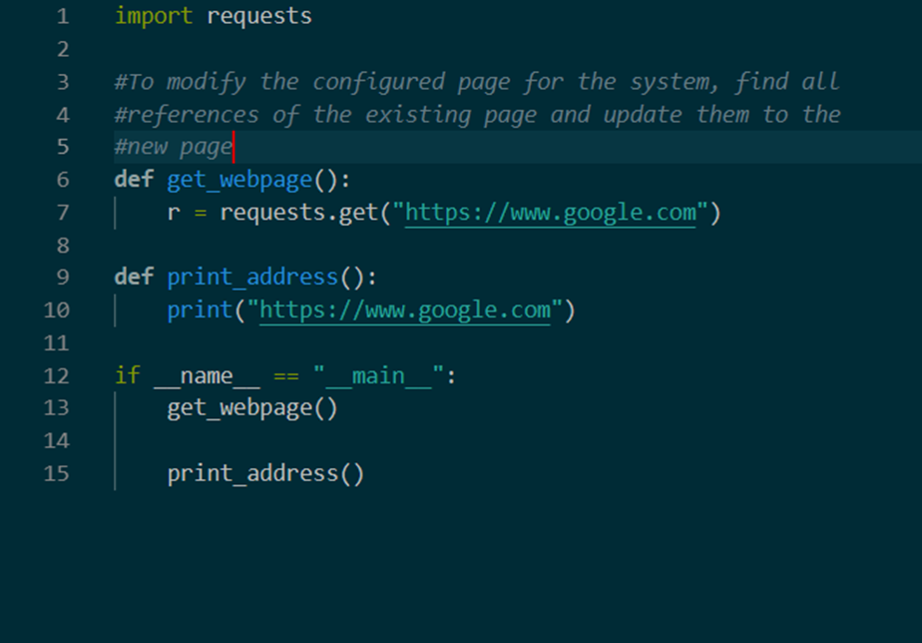
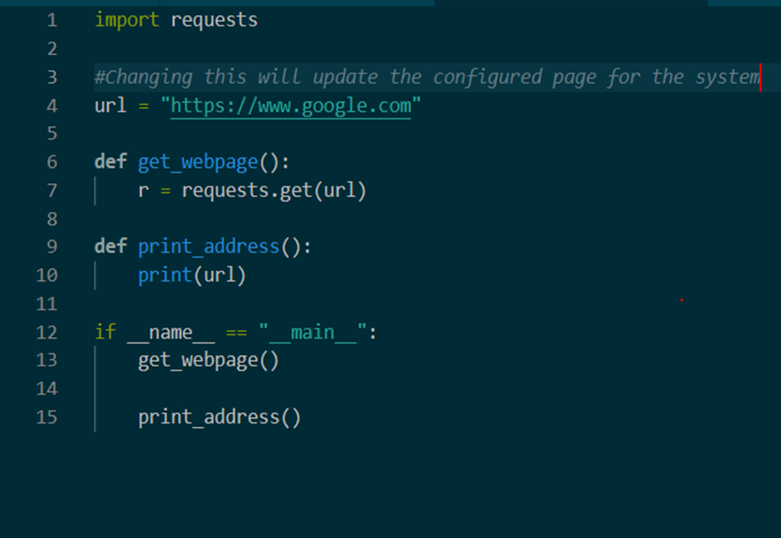
Example of complexity

Slide 6
System Design Considerations
What are symptoms of complexity?
IMAGE Attribution: https://www.journalofaccountancy.com/issues/2015/apr/financial-reporting-auditing-complexity.html
Notes:
Can you easily build a good conceptual model of the system? Think Linux CLI
Change amplification
Two (three) main causes:
Dependency
Obscurity (lack of signaling)
Error handling
Excessive documentation or lengthy explanations
Unknown unknowns:
It’s not obvious where to start modifying the code to accomplish a goal
This can be very frustrating to deal with and requires a lot of patience
Cognitive load:
Will this change make things easier for other developers?
Change amplification:
A simple change requires modifying the code in multiple places
Design your code such that you reduce the number of modifications necessary to introduce a feature

Slide 7
Applications to Systems
What Creates Complexity?
IMAGE Attribution: https://www.journalofaccountancy.com/issues/2015/apr/financial-reporting-auditing-complexity.html
Notes:
Organizational challenges
Strategic vs tactical programming
Unclear goals or objectives
Speculative generality
When good intentions go bad
YAGNI
Time
Lack of governance
Poor initial design

Slide 8
Applications to Systems
How can we reduce complexity?
IMAGE Attribution: https://www.journalofaccountancy.com/issues/2015/apr/financial-reporting-auditing-complexity.html
Notes:
1. Look for outdated features, unneeded cruft, etc.

Slide 9
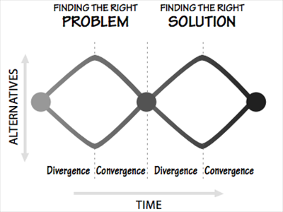
Elements of Design Thinking
Design Process Overview
Notes:
Start by questioning the problem you’ve been given but be careful of scope creep
Examine all fundamental issues associated with the problem and then converge on a single problem statement
Expand the scope of possible solutions, and then converge onto one (the MVP)
Now let’s talk about how we do that…

Slide 10
Elements of Design Thinking
“Engineers and businesspeople are trained to solve problems. Designers are trained to discover the real problem” - Don Norman

Slide 11
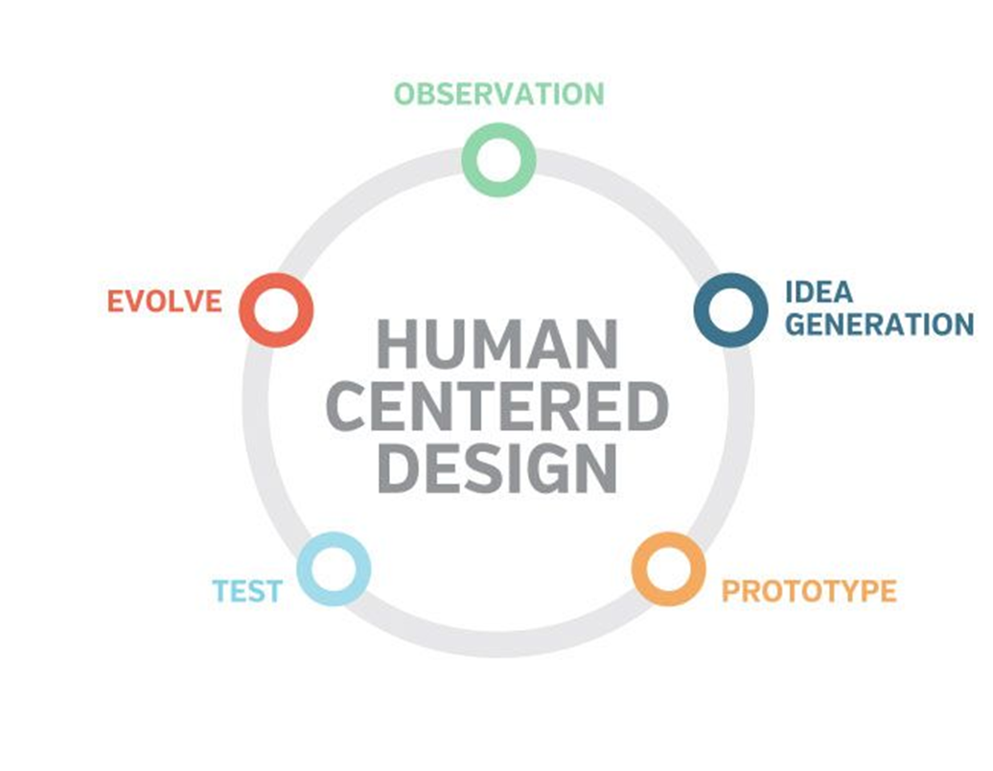
Elements of Design Thinking
IMAGE ATTRIBUTION: https://www.pinterest.com/pin/223631937727682879/
Notes:
Constant iteration gets you closer and closer to a desired solution

Slide 12

Elements of Design Thinking
Observation – watching behaviors
IMAGE ATTRIBUTION: https://lemonadverts.com/wp-content/uploads/2018/04/ideation-concepts.png
Notes:
Observe behaviors and activities – use me as an example

Slide 13
Elements of Design Thinking
Ideation – generating ideas
IMAGE ATTRIBUTION: https://lemonadverts.com/wp-content/uploads/2018/04/ideation-concepts.png
Notes:
This is the fun part! Generate lots of solutions

Slide 14
Elements of Design Thinking
Prototyping – developing the solution
IMAGE ATTRIBUTION: https://lemonadverts.com/wp-content/uploads/2018/04/ideation-concepts.png
Notes:
Used to help ensure that the problem is well understood

Slide 15
Elements of Design Thinking
Testing the solution
IMAGE ATTRIBUTION: https://lemonadverts.com/wp-content/uploads/2018/04/ideation-concepts.png

Slide 16
Elements of Design Thinking
Iteration – fail frequently, fail fast
IMAGE ATTRIBUTION: https://lemonadverts.com/wp-content/uploads/2018/04/ideation-concepts.png
Notes:
Testing allows you to determine whether or not the solution meets the requirements and allows you to prepare for the next iteration of the solution

Slide 17

Consequences of Bad Design
Usage Errors
IMAGE ATTRIBUTIONhttps://www.wired.com/2014/04/perfect-terrible-redesigns/

Slide 18
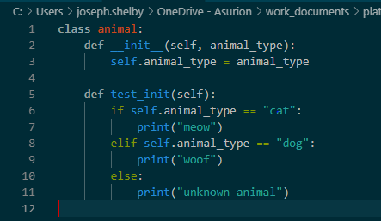

Slide 19

Consequences of Bad Design
Increased Cognitive Load
IMAGE ATTRIBUTIONhttps://www.wired.com/2014/04/perfect-terrible-redesigns/

Slide 20
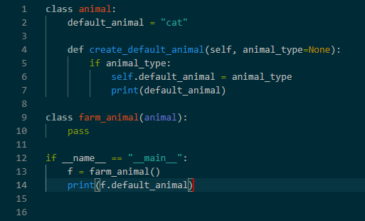

Slide 21
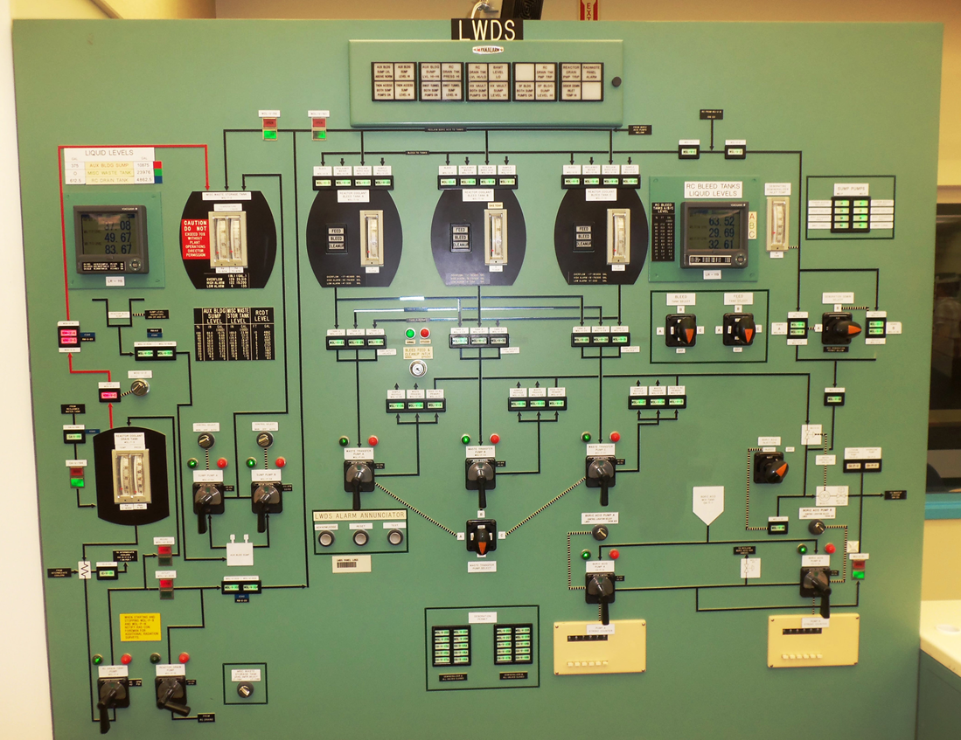
Consequences of Bad Design
Complex Maintenance Procedures
Notes:
Operational overhead
Customer impacts

Slide 22
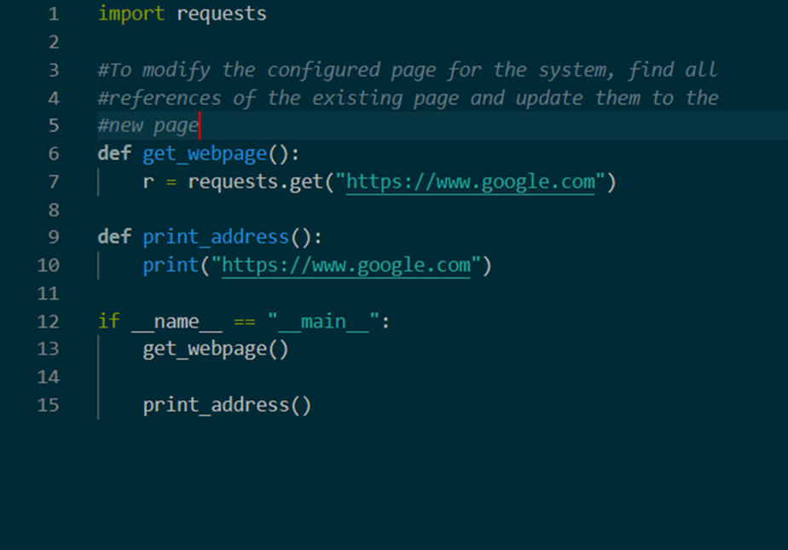

Slide 23
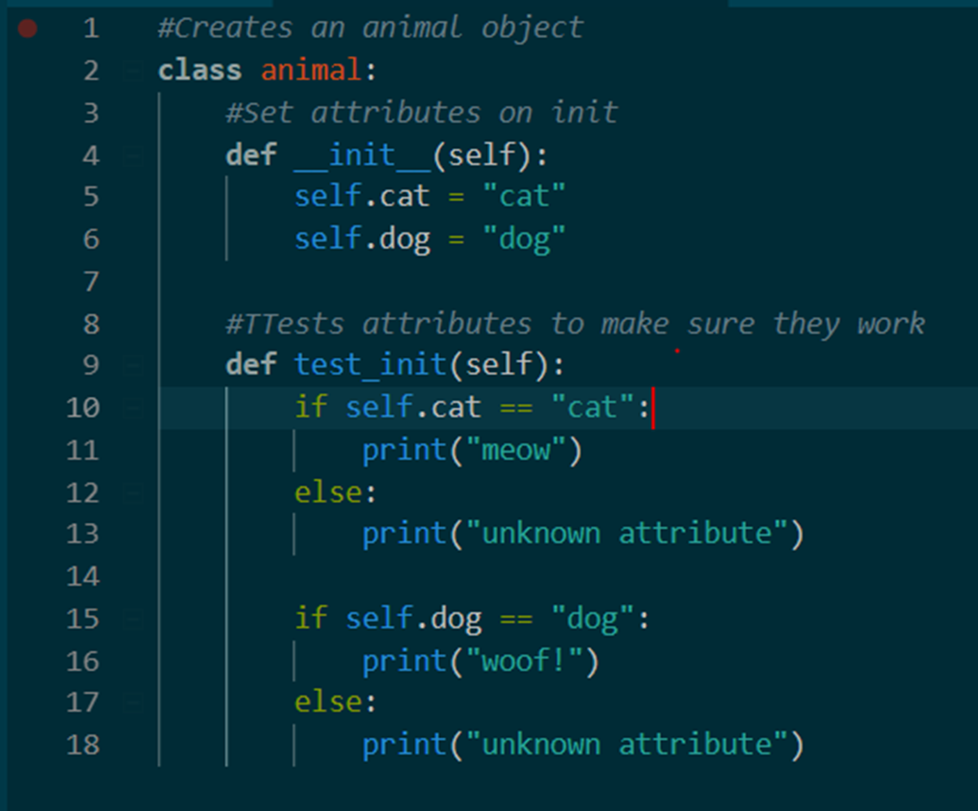
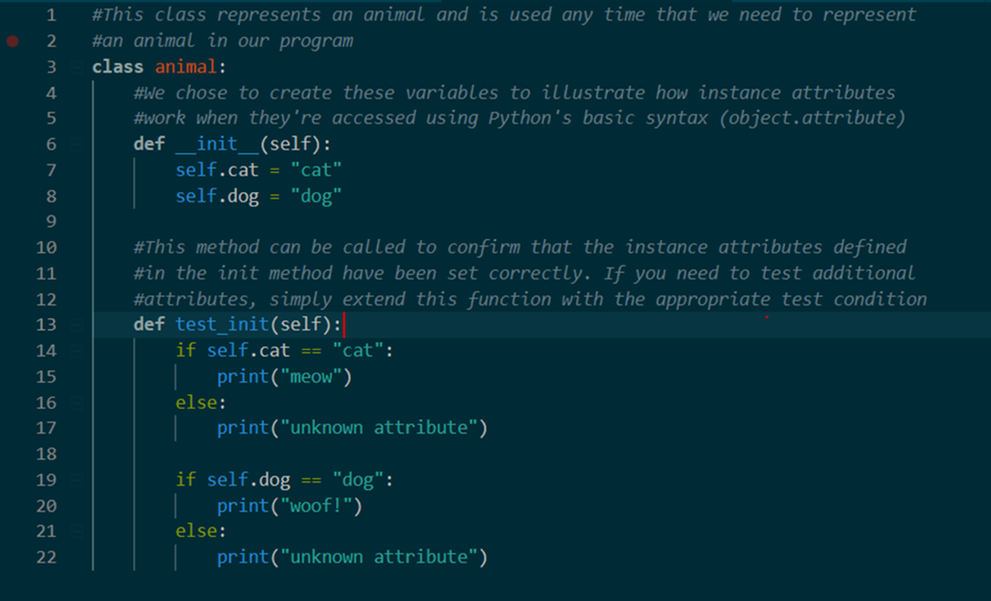
Why comments are important
Notes:
A signifier is a sign or an example of how to interact with a system or object
An affordance is what you can do with a system
Comments should add either precision or intuition
Low-level comments add precision by clarifying the meaning of the code
Higher-level comments add intuition by explaining the reason for the code
Comment variables by their contents; not how they’re being manipulated
Consider the following:
What is the code trying to do? What is the simplest way to explain what it’s doing? What’s the most important thing about it?
Good comments should reflect the INTENT of the designer
They should also describe things that aren’t obvious from the code
Abstractions are by their nature a simplification; code (aka the implementation of an abstraction) is often too detailed
Good abstractions necessitate good comments

Slide 24
Questions?

Slide 25
Resources for Further Reading
A Philosophy of Software Design – John Ousterhaut
Clean Code – Robert C. Martin
Clean Architecture – Robert C. Martin
Joel on Software (https://www.joelonsoftware.com)
Pragmatic Programmer – Andrew Hunt/David Thomas
The Design of Everyday Things – Don Norman
Slides available at https://github.com/os2tux/pynash_20191121.git

